Slide 1
Chapter 9 Review
Graphing Quadratic Equations
Solve by factoring
Solve by graphing
Solve by Square Root
Solve by completing the square
Solve using the Quadratic Formula

Slide 2
Rules
Your desks will be staying in rows.
A question will be presented and you will have two minutes to solve the question in your spiral.
Remember to number the questions and show the original problem.
Do the work in two organized legible columns so that you can use this to review for the test
Then you will be given two minutes to talk with your neighbors.
Do you guys agree on your answer?
How did you get there? What was your process?
Then you will get the answer, followed by the next question.

Slide 3
Solve by factoring
$$x^{2}+x−2=y$$

Slide 4
$$x^{2}+x−2=0$$
$$\left(x+2\right)\left(x−1\right)=0$$
$\left(x+2\right)=0$
$\left(x−1\right)=0$
$$−2,1$$

Slide 5
Identify the Axis of symmetry and the vertex. Then graph the following equations
$$y=−x^{2}+3$$

Slide 6
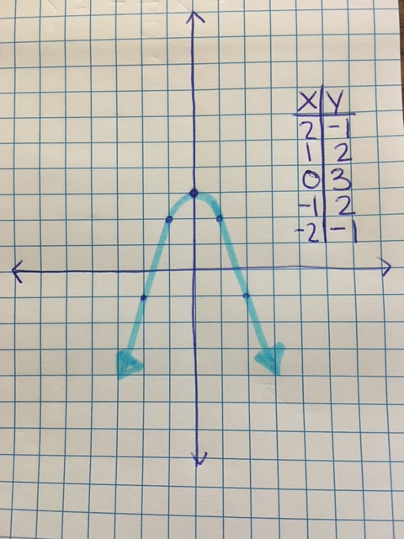
$$x=0$$
$$(0,3)$$

Slide 7
Solve by completing the square. Leave your solution in simplest radical form.
$$x^{2}+8x+9=0$$

Slide 8
$$x=−4+\sqrt{7}$$
$$x=−4−\sqrt{7}$$

Slide 9
Solve by taking the square root of both sides
$$x^{2}−24x+144=36$$

Slide 10
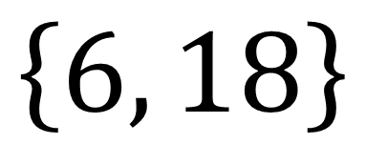
$$\left\{6, 18\right\}$$

Slide 11
Solve using the Quadratic Formula. Leave your solution in simplest radical form.
$$2x^{2}=6x −4$$

Slide 12
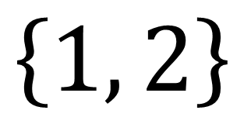
$$\left\{1, 2\right\}$$

Slide 13
Solve by graphing.
$$−x^{2}+7=y$$

Slide 14
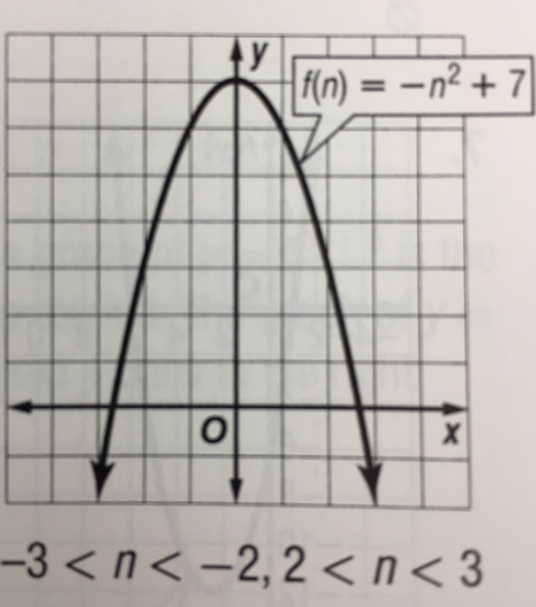
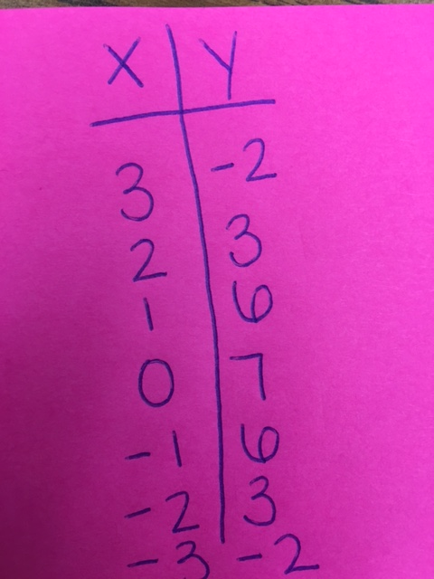
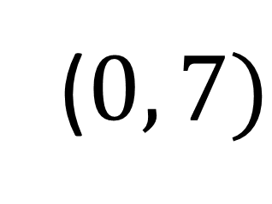
$$x=0$$
($0, 7)$

Slide 15
Solve by Factoring
$$x^{2}+4x+5=y$$

Slide 16
$$No Real Roots$$

Slide 17
Will the graph of the parabola open up or down?
$${−3x+4y}^{2}−12$$

Slide 18
$$UP$$

Slide 19
Solve using the Quadratic Formula. Leave your solution in simplest radical form.
$$24x^{2}−14x=6$$

Slide 20
$$x=\frac{14−\sqrt{772}}{48}$$
$$x=\frac{14+\sqrt{772}}{48}$$

